Slide 1



Progress Presentation 02
Mobile application to scan and Extract
Historically and Architecturally accurate data of an
Archaeological Object
24-25J-092

Slide 2



Introduction
The study of archaeological objects is crucial for understanding human history and cultural heritage.
Traditional documentation and analysis methods are,
Time-consuming , Require specialized equipment , Prone to human error.
The research focuses on developing a mobile application to - Scan archaeological objects , Extract historically and architecturally accurate data.

Slide 3


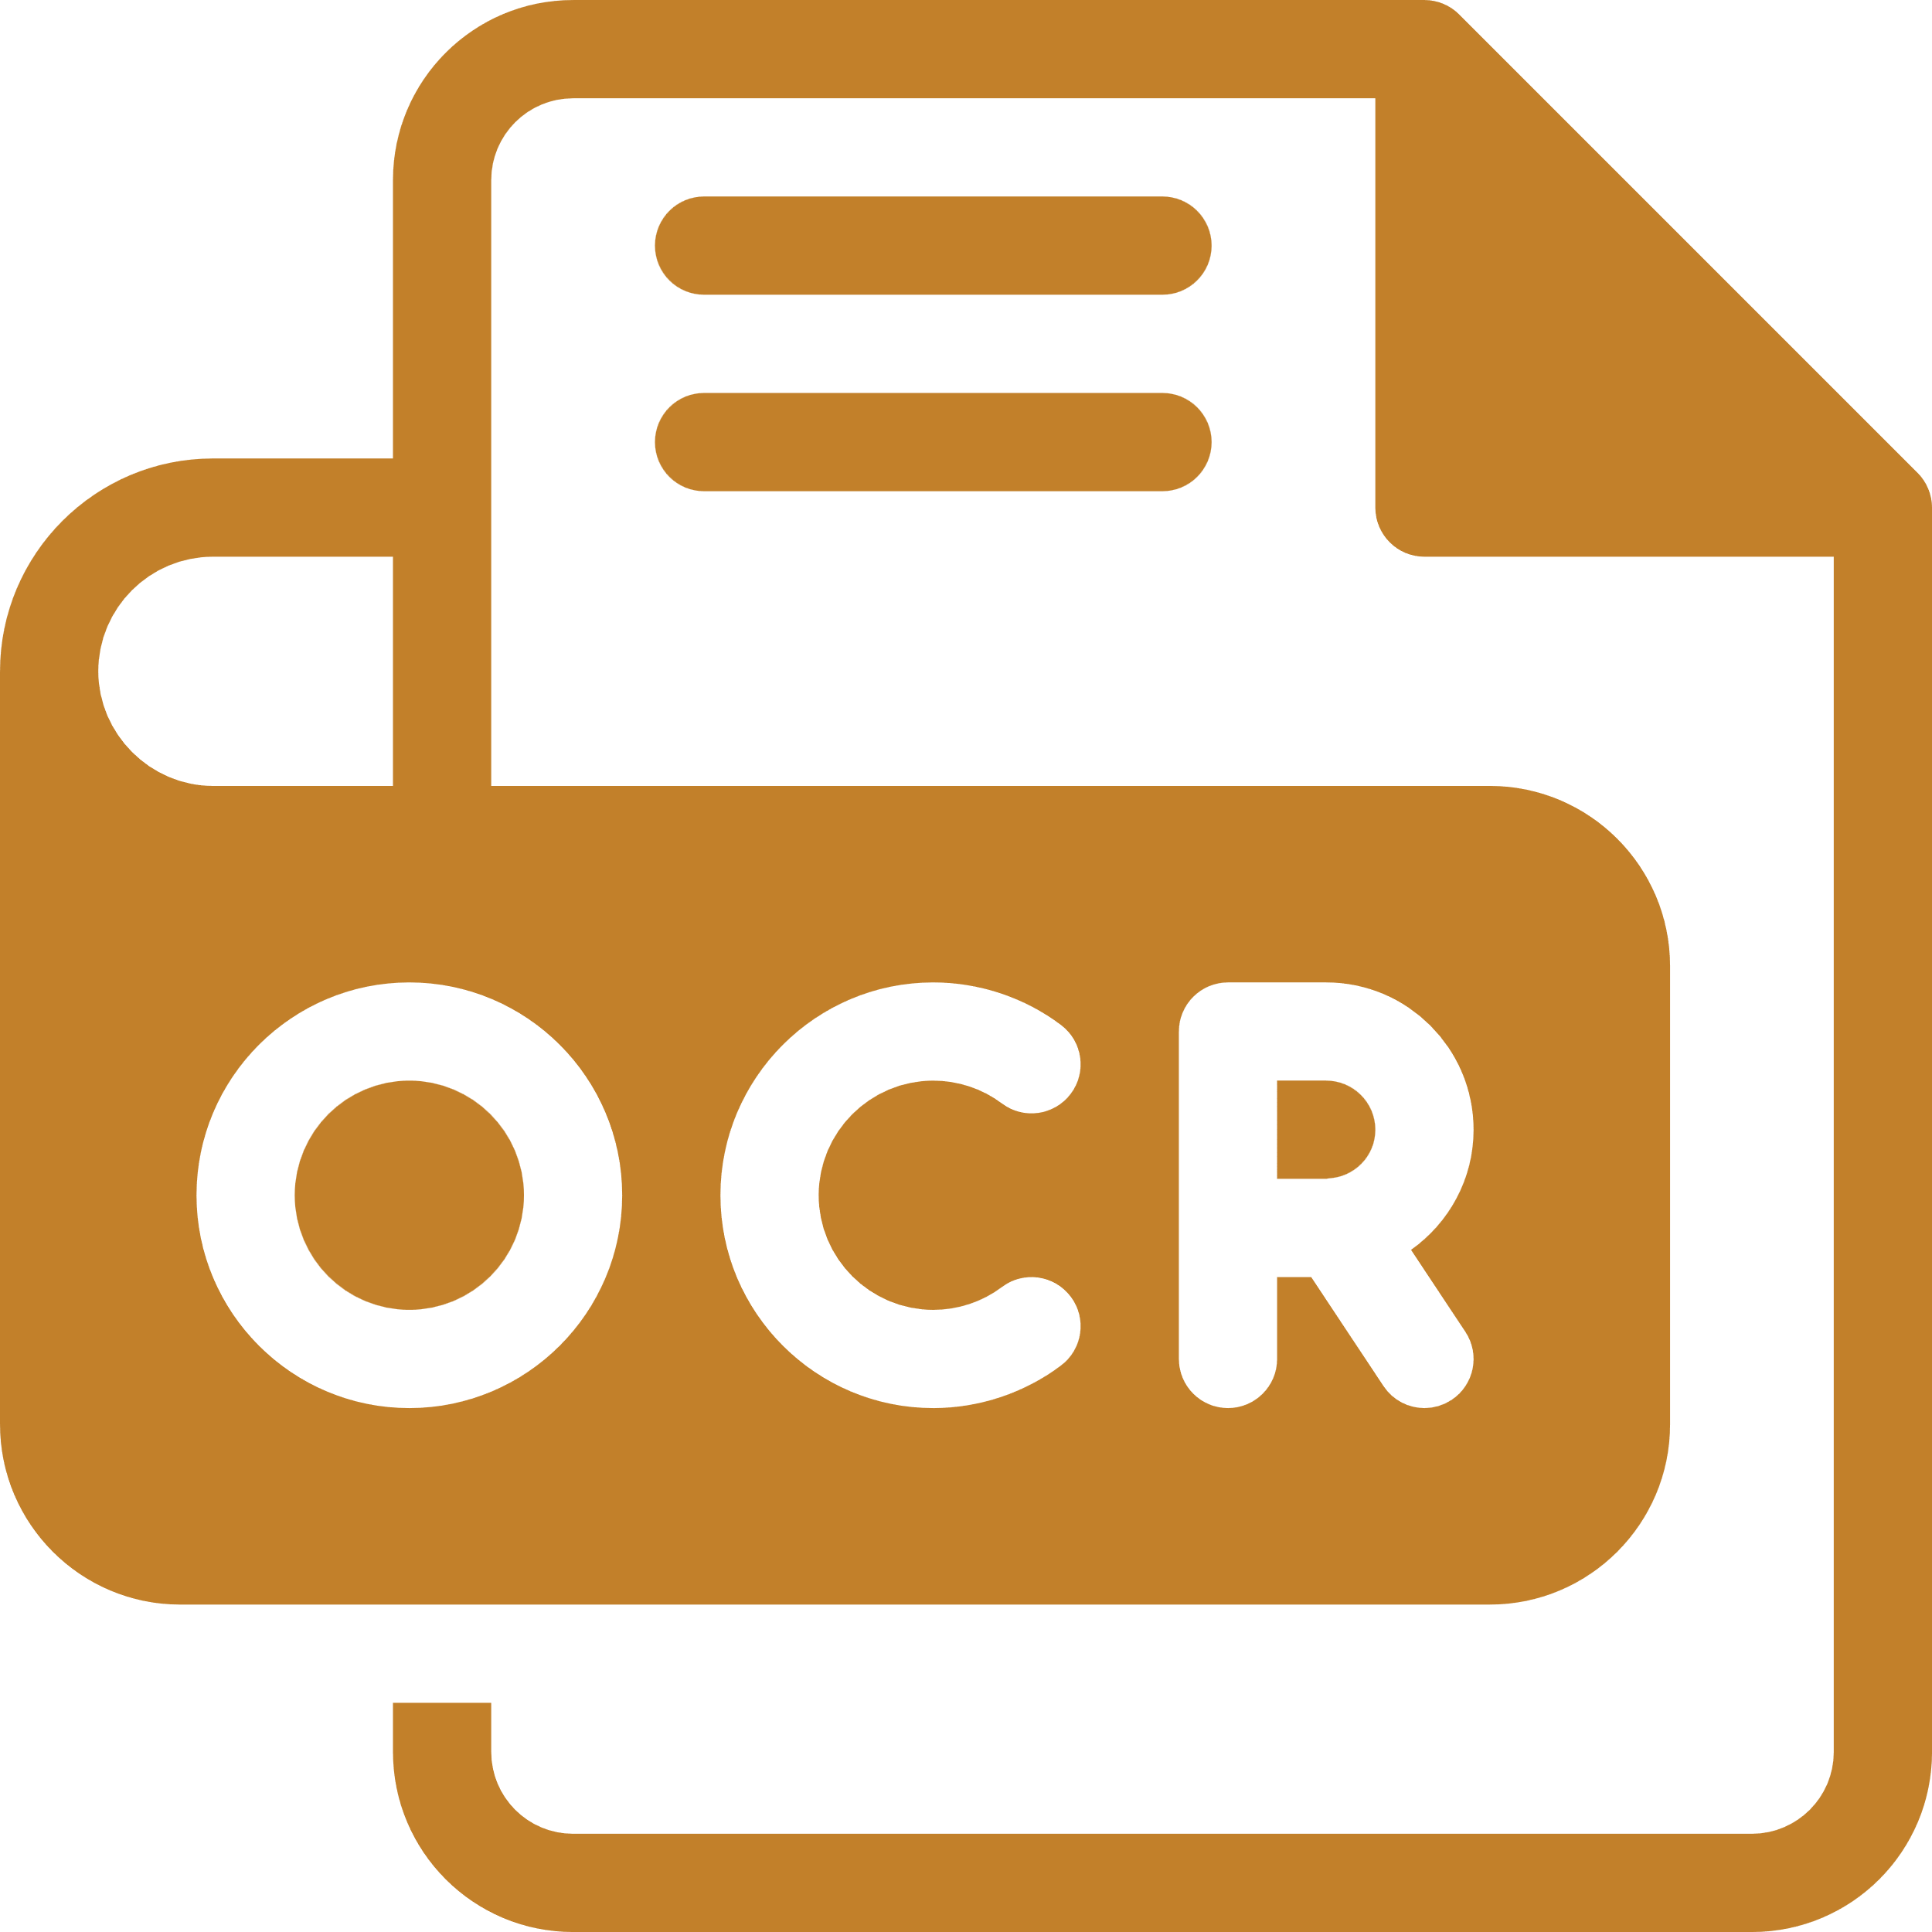



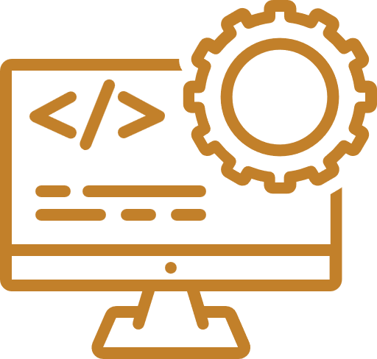

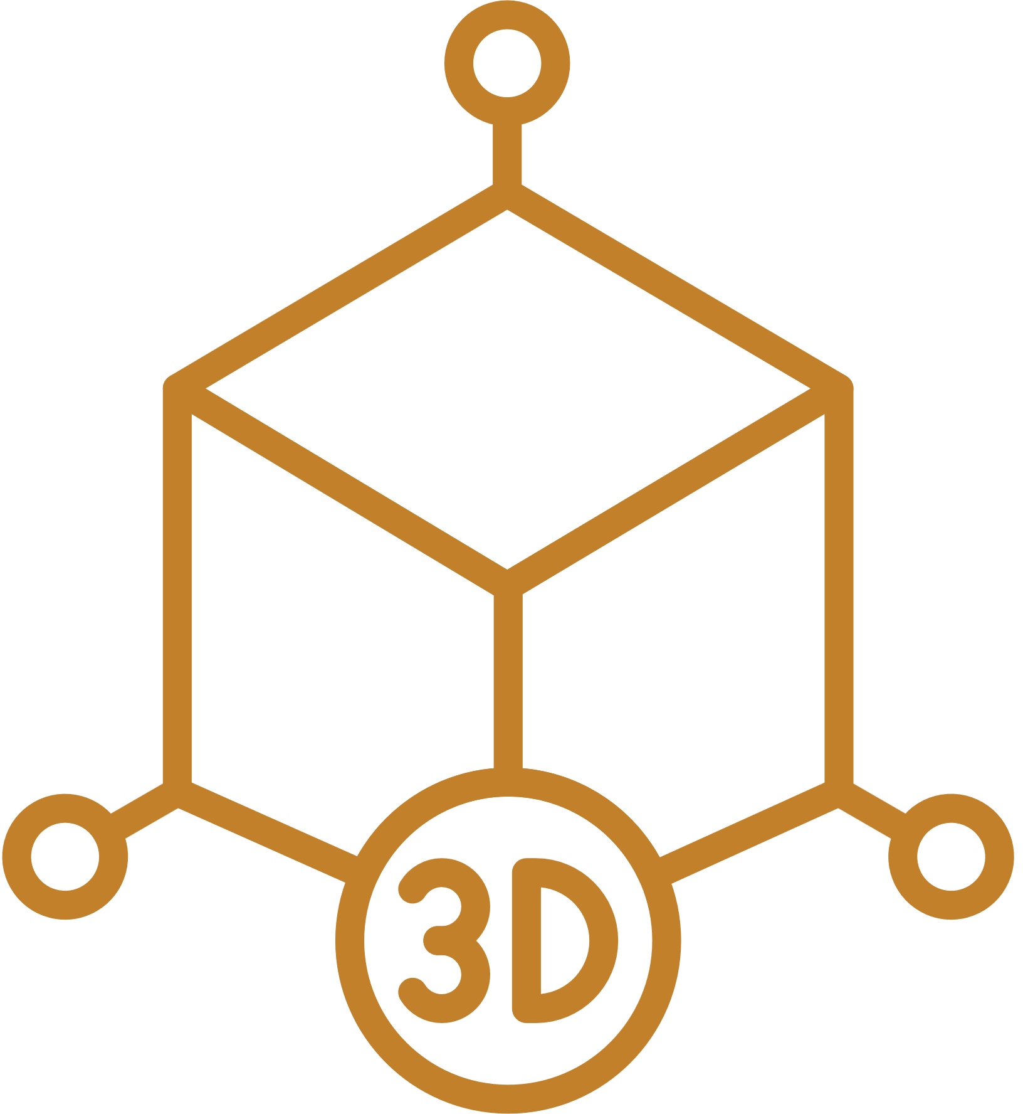

Overall System Diagram
Historical Object Detection
Database
Brahmi Script OCR
CNN Model
Mobile Application
Backend
Architectural Feature Detection
Photogrammetry Neural Rendering
3D Object Prompt Generation

Slide 4
Contribution & Results

Slide 5
IT21344824
T.E.M.A.P. Ekanayake

Slide 6
3D Object prompt generation
The preservation and study of archaeological objects are essential for understanding human history and cultural heritage.
Traditional methods of documenting and analyzing these artifacts are often time-consuming,
the ability to generate accurate 3D models from 2D images, which can significantly enhance the analysis and preservation of archaeological objects.
It’s more detailed and comprehensive making it more understanding of archaeological artifacts
Objective: Aims to create a mobile application capable of scanning, analyzing, and reconstructing 3D models of archaeological artefacts with high accuracy.

Slide 7
Why build this?
Challenges in Current Systems
Time-Consuming Documentation
High Equipment Costs
Human Error & Inaccuracy
Limited Accessibility
Automation Benefits
Speed & Efficiency
Scalability
Cost-Effective
Improved Accuracy

Slide 8
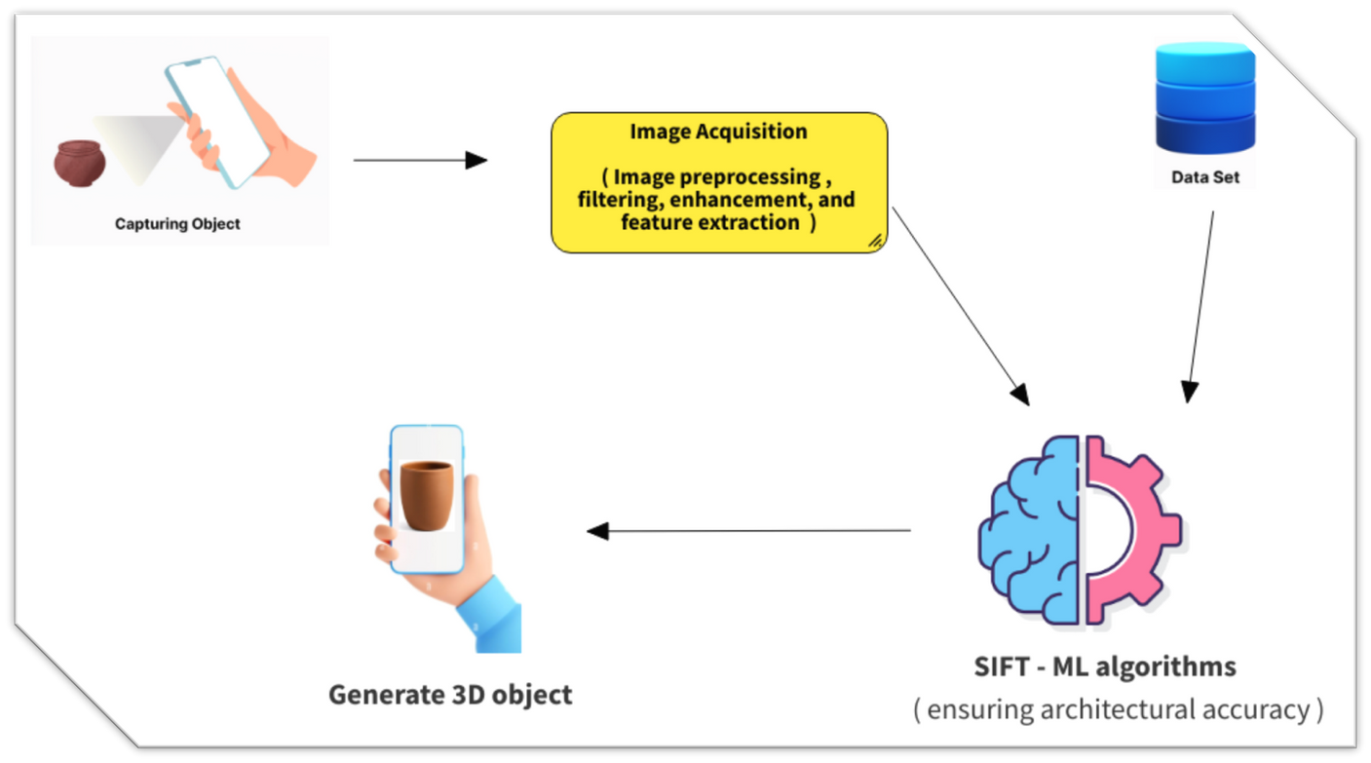
Methodology System Diagram

Slide 9
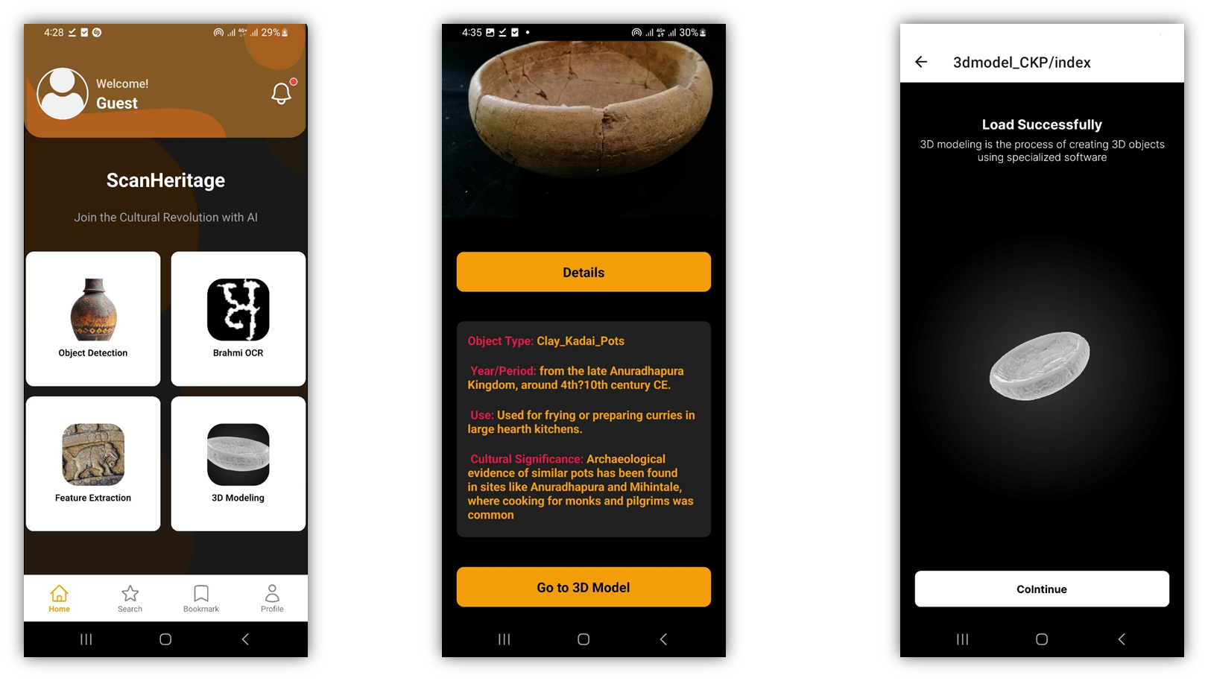
Component Flow

Slide 10
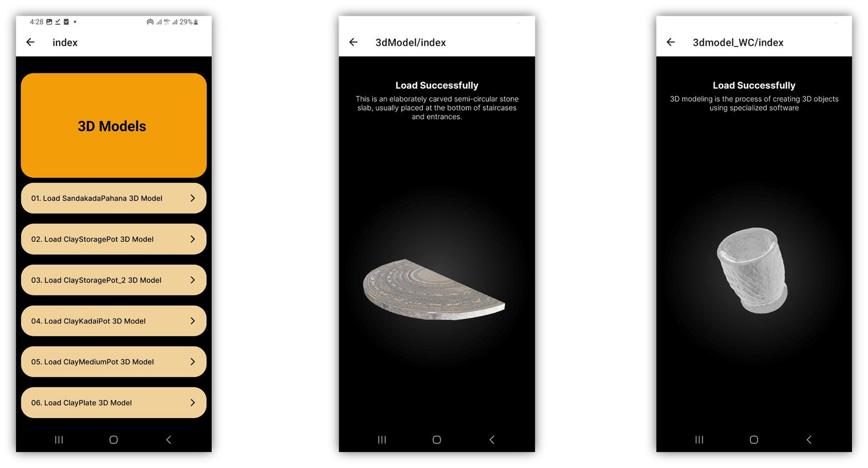
Component Flow

Slide 11
Used Technologies
Frontend
React native
Nativewind (tailwind css)
React Reanimated
Three.js
Backend
Flask
Mongo DB
JWT(Json web token)
API Integration
Cloudinary
Model training
Python
TensorFlow
Pytorch
flask
Jupyter Notebook
3D Modeling
•TripoSR
•Blender

Slide 12
Benefits of Implementing This System
Enhanced Cultural Heritage Preservation – By digitizing artefacts, the system ensures long-term conservation and reduces the risk of physical damage.
Increased Accessibility – Researchers, students, and the public can explore historical artefacts without geographical constraints.
Real-Time Interaction – Users can interact with 3D models using AR, gaining deeper insights into historical and architectural details.
Seamless Data Storage & Retrieval – Cloud-based storage enables quick access to artefact data for future study and collaboration.

Slide 13
IT21352294
J.R.K.B. Jayawardhana

Slide 14
Object Detection and Data Retrieval
Comprehensive Dataset Collection: Curate a specialized dataset of archaeological objects, capturing unique features for high-quality model training.
Machine Learning Model Training: Train advanced machine learning models, particularly CNNs, to accurately recognize and classify archaeological artifacts.
Novelty : competitors like Google Art have a virtual tour of for historical object but not focus on the sri lankan historical objects but this project we are only focus on sri lankan historical objects.
API Development and Continuous Updates: Develop an API for mobile app integration and continuously update models with new data for accuracy and relevance.

Slide 15
Why build this?
Challenges in Current Systems
Limited Dataset Availability
Manual Identification
Lack of Standardized Recognition Systems
Automation Benefits
Faster Processing
Scalability
Real-time Identification
Enhanced Accuracy

Slide 16
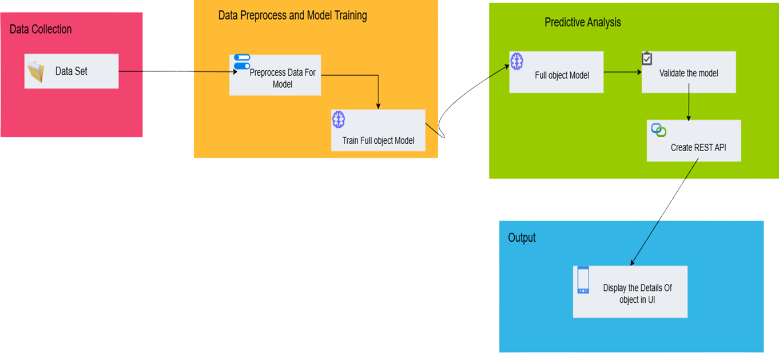


Methodology System Diagram

Slide 17
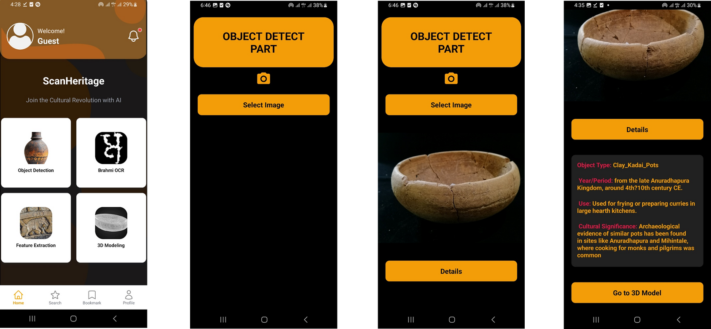
Component Flow

Slide 18
Used Technologies
Frontend
React native
Nativewind (tailwind css)
React Reanimated
Backend
Flask
Mongo DB
JWT(Json web token)
Model training
Python
TensorFlow
Pytorch
flask
Jupyter Notebook
API Integration
Cloudinary

Slide 19
Benefits of Implementing This System
Preservation of Sri Lankan Heritage – Helps document and digitally preserve historical artifacts, ensuring their cultural significance is maintained for future generations.
Public Engagement and Awareness – Encourages people to explore and learn about Sri Lanka’s rich history through an interactive digital platform.
Support for Museums and Cultural Institutions – Museums can use the system to catalog and manage their collections efficiently.
Scalability and Adaptability – The system can grow by continuously integrating new data, keeping the model up-to-date with the latest discoveries.

Slide 20
IT21360978
Serasinghe G.P.G.Y

Slide 21
Brahmi Script OCR and Data Retrieval
Automates the extraction and translation of ancient Brahmi inscriptions using Optical Character Recognition (OCR) and deep learning techniques. By recognizing and digitizing historical texts, it enhances accessibility to ancient knowledge while preserving cultural heritage. Advanced AI models preprocess images to reduce noise, improve character segmentation, and accurately recognition Brahmi script and modern languages. This innovation facilitates historical research, linguistic analysis, and digital preservation of ancient texts.
Objective: Aims to create an AI-powered OCR system that can accurately recognize and extract Brahmi script from historical and modern inscriptions, thereby ensuring the accessibility and preservation of ancient texts.

Slide 22
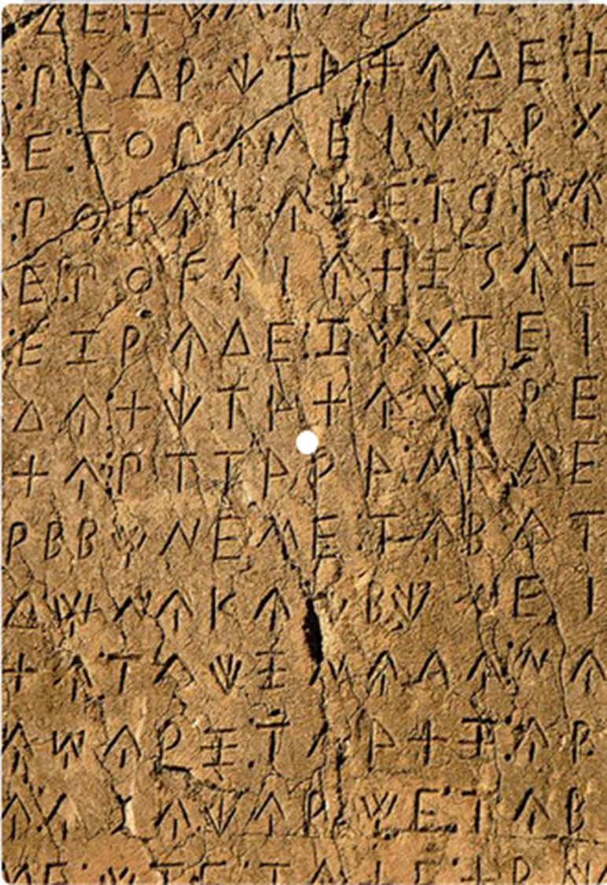
Why build this?
Challenges in Current Systems
Discuss the limitations of current methods for reading and documenting Brahmi inscriptions.
Limited Accessibility
Error-Prone Manual Transcription
Degradation of Inscriptions
Lack of Standardized Digital Databases
Automation Benefits
Increases Accuracy
Saves Time
Enhances Preservation
Improves Accessibility

Slide 23
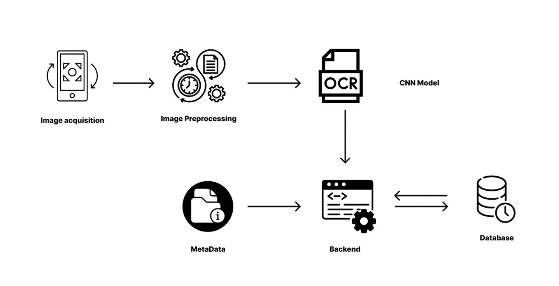
Methodology System Diagram

Slide 24
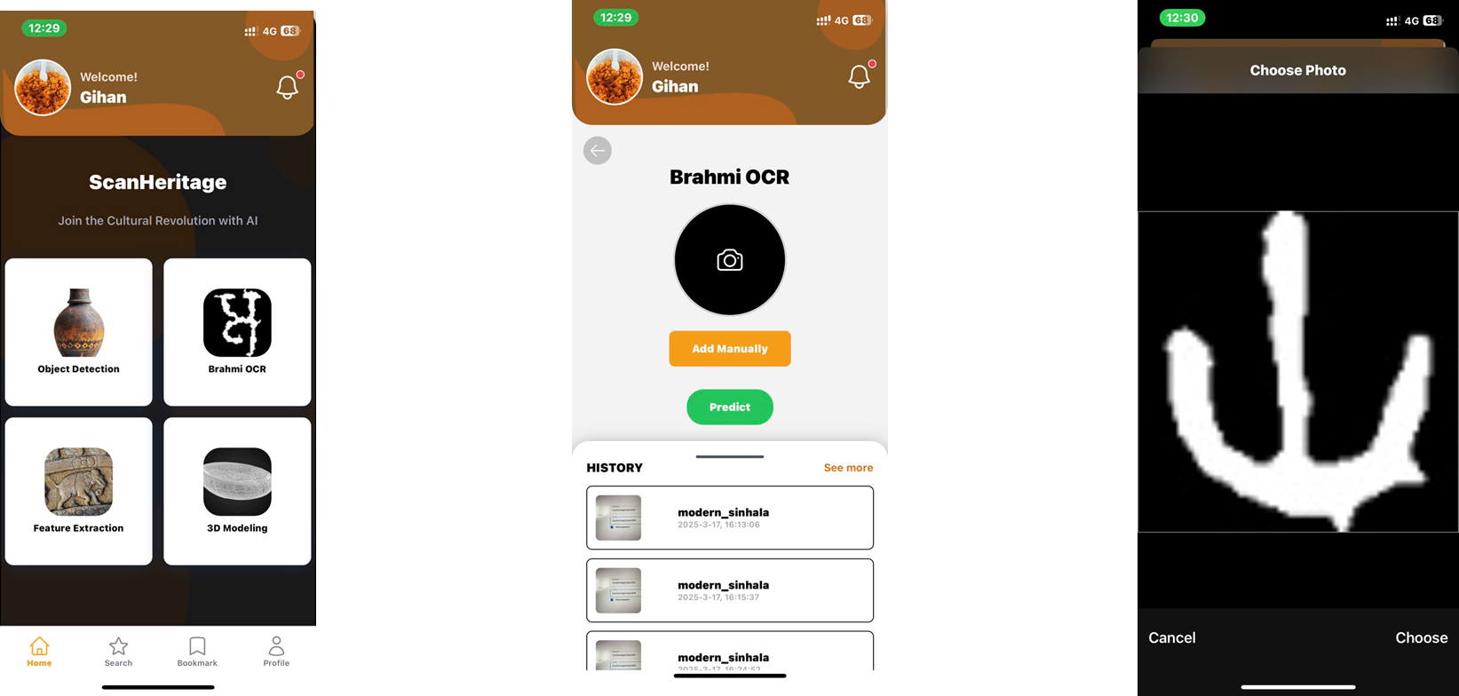
Component Flow

Slide 25
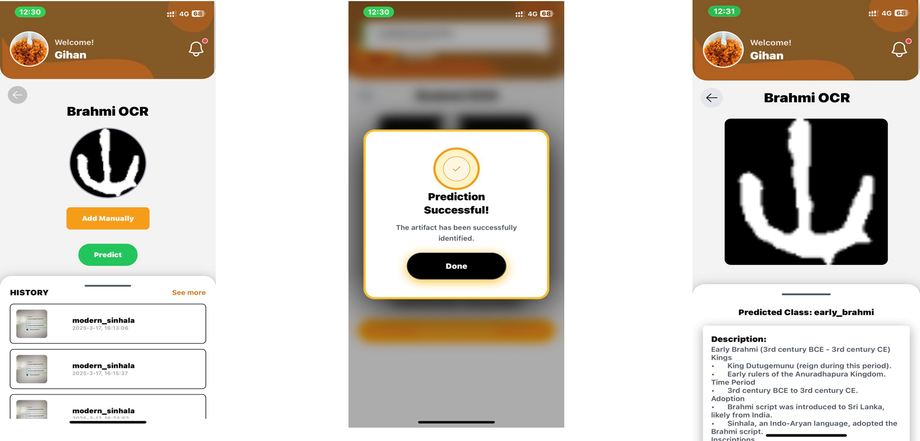
Component Flow

Slide 26
Used Technologies
Frontend
React native
Nativewind (tailwind css)
React Reanimated
Backend
Flask
Mongo DB
JWT(Json web token)
API Integration
Cloudinary
Model training
Python
TensorFlow
Pytorch
flask
Jupyter Notebook
Google Collab
NumPy
OpenCV

Slide 27
Benefits of Implementing This System
Enhanced Efficiency –This OCR enables real-time extraction and recognition of Brahmi inscriptions, reducing the time required for manual transcription.
Improved Accuracy – Deep learning algorithms enhance character recognition, minimizing errors in decoding ancient texts.
Preservation of Historical Knowledge – Digitizing inscriptions ensures that valuable historical information is stored and protected for future generations.
Greater Accessibility – Researchers, historians, and the public can easily access and analyze translated inscriptions through a unified digital platform.
Reduced Manual Effort – Automates the labor-intensive task of deciphering ancient scripts, freeing up experts to focus on higher-level historical analysis.

Slide 28
IT21273094
Ediriwickrama E.A.K.V.

Slide 29
Architectural Feature Detection in Historical Analysis
This automates the identification and classification of architectural elements in historical structures using deep learning and computer vision. By analyzing features such as arches, columns, and domes, the system provides insights into architectural styles, historical significance, and cultural influences. Feature detection enhances the accuracy of historical analysis while aiding conservation efforts. This innovation supports archaeologists and historians by streamlining research and documentation of ancient structures.
Objective: Aims to develop an AI-based system that can automatically detect and classify architectural elements in historical structures, thereby enhancing cultural heritage conservation.

Slide 30
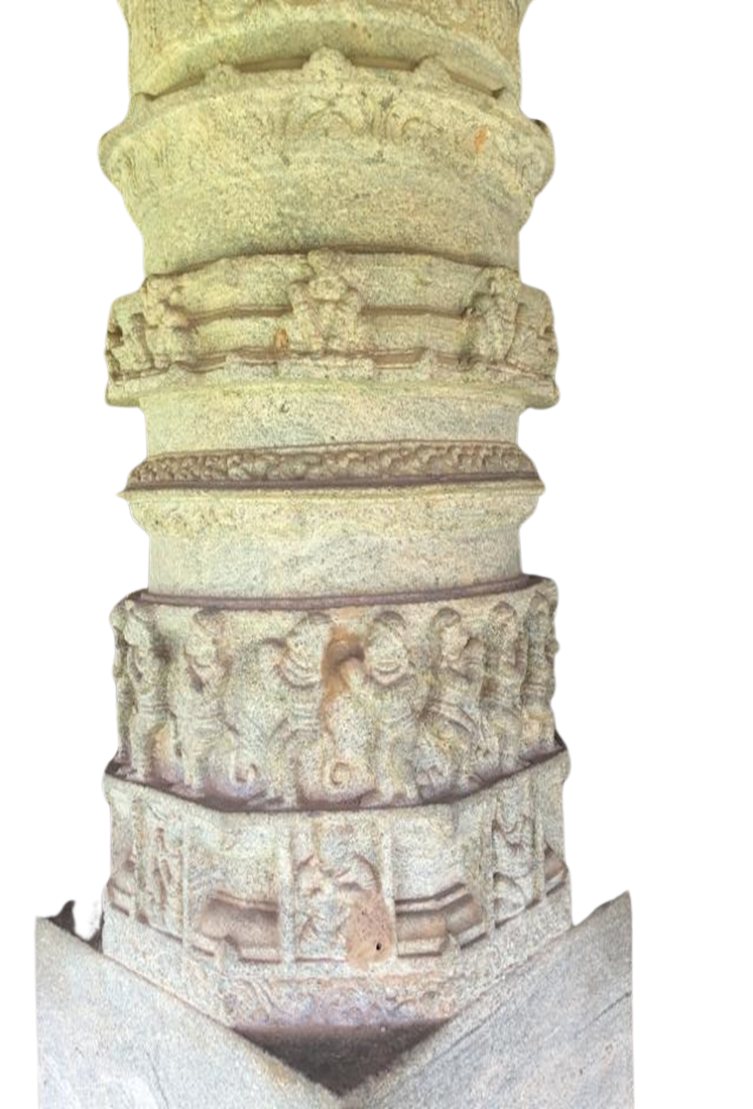
Why build this?
Challenges in Current Systems
Discuss the limitations of traditional architectural feature detection in archaeological research.
Manual Analysis is Time-Consuming
Inconsistent Documentation
Structural Degradation
Lack of Real-Time Analysis
Automation Benefits
Faster and More Accurate Analysis
Preserves Historical Knowledge
Enhances Accessibility
Supports Cultural Conservation

Slide 31
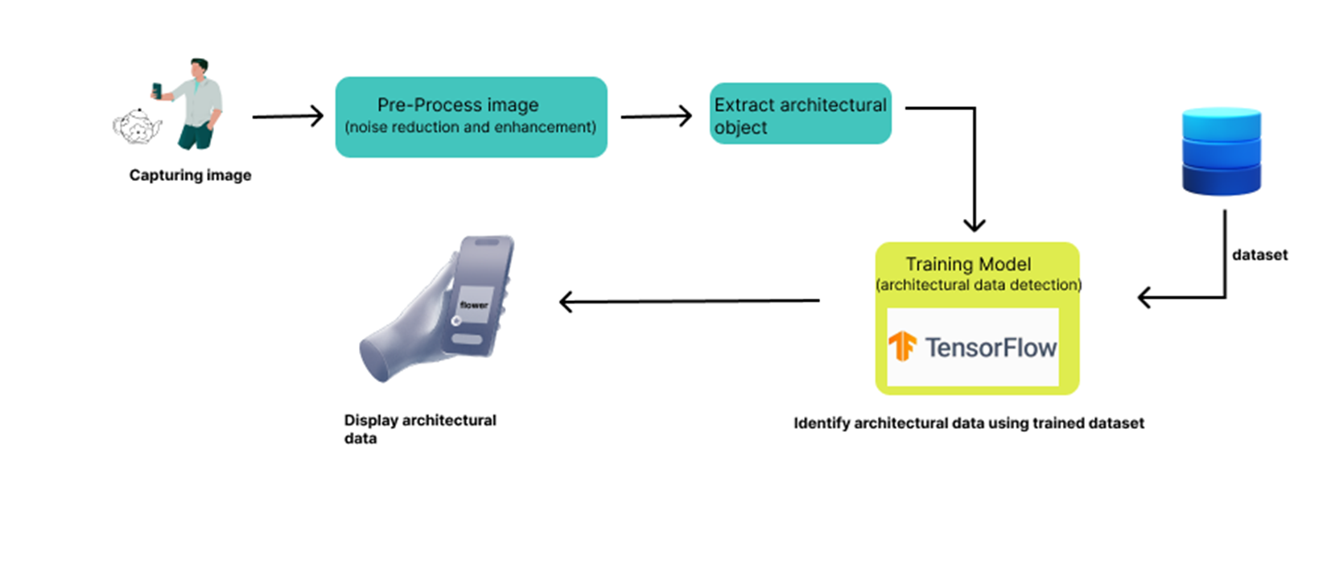
Methodology System Diagram

Slide 32
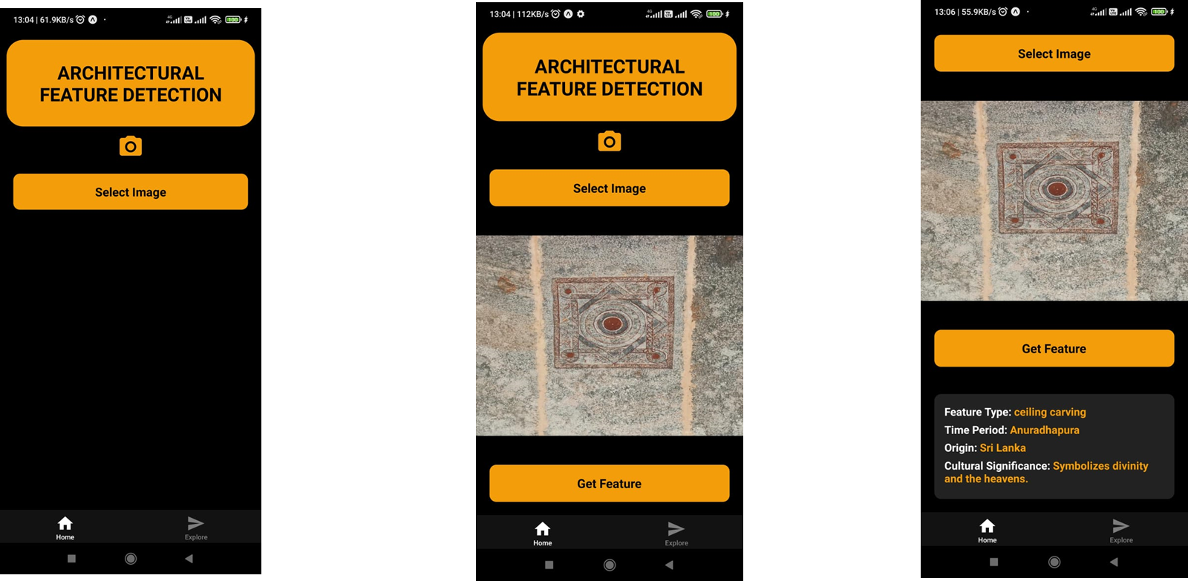
Component Flow

Slide 33
Used Technologies
Frontend
React native
Nativewind (tailwind css)
React Reanimated
Backend
Flask
Mongo DB
JWT(Json web token)
Model training
Python
TensorFlow
Pytorch
flask
Jupyter Notebook
Google Collab
NumPy
OpenCV

Slide 34
Benefits of Implementing This System
Automated Structural Analysis – AI-driven detection streamlines the classification of architectural elements, reducing reliance on manual documentation.
Faster Research and Documentation – Real-time identification of historical structures accelerates research and heritage conservation efforts.
Higher Accuracy in Historical Classification – Deep learning ensures precise recognition of architectural styles and elements, improving data consistency.
Increased Accessibility – Mobile and web-based applications make architectural analysis available to researchers, conservationists, and educators worldwide.

Slide 35
Thank You

